Slide 1

Vibration of tool due to tool chatter in turning operation on Lathe
ME 531 : Mechanical Vibration
Group No:- 11
Gaurang Sanjay Kargutkar - 234103417
Shivam Kumar Jaiswal -234103437
Amit Singh - 234103405

Slide 2
Objectives
Study of various parameters resulting in tool chatter during orthogonal turning operation.
Theoretical Analysis using Spring Mass and Damper model.
Deriving the Equation of Motion of Model and Solving it using MATLAB.
Simulation of vibration Amplitude of tool due to chattering
in turning operation using MATLAB Simulink.
Effect of various parameters on Tool Chatter.

Slide 3
Introduction
Tool chatter is defined as the relative movement between the work piece and the cutting tool.
Tool bounces in and out of the work piece
The vibrations result in waves on the machined surface. This affects typical machining processes, such as turning, milling and drilling etc. It results in irregular surface.
This in turn reduces machine tool life, reliability and safety of the machining operation.
To reduce the machining vibrations, we use spring and damper system ,so that we get good surface finish and less tool wear.

Slide 4
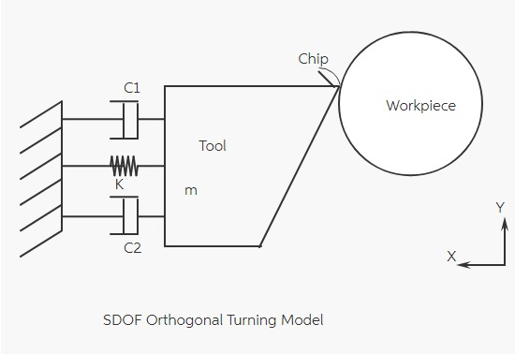
Spring-mass damper Model
A mathematical model considering a Single Degree of Freedom orthogonal turning process with a flexible tool and relatively rigid work piece is considered as shown in below figure. The model incorporates various forces acting on the physical system like the inertia force, damping force, spring force and the cutting force.

Slide 5
When this Single degree of freedom flexible tool is cutting a rigid work piece, the equation of motion(EOM) of the dynamic system was derived using Newtons 2nd law in the radial (feed) direction as:
mẍ(t) + (c1 + c2)ẋ(t) + kx(t) = F_{f}(t)
The tool parameters m, k and c1 and c2 are the mass, stiffness and damping co-efficient, respectively,
F_{f}(t) = K_{c} b[ x(t-T) – x(t) ]
Where,
K_{c} is the cutting coefficient in feed direction
b is the chip width (width of cut)
T is the time delay between current time and previous time
[x(t-T)-x(t)] is the dynamic chip thickness due to tool vibration.

Slide 6
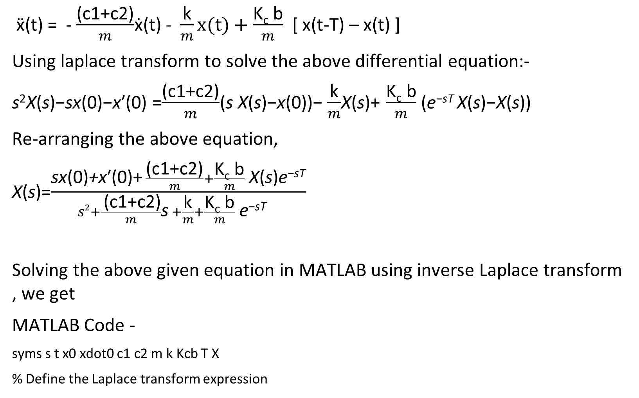
ẍ(t) = - $\frac{\text{(}\text{c}\text{1}\text{+}\text{c}\text{2}\text{)}}{m}$ẋ(t) - $\frac{\text{k}}{m}x(t)+\frac{\text{K}\text{c} \text{b}}{m}$ [ x(t-T) – x(t) ]
Using laplace transform to solve the above differential equation:-
s²X(s)−sx(0)−x′(0) =$\frac{\text{(}\text{c}\text{1}\text{+}\text{c}\text{2}\text{)}}{m}$(s X(s)−x(0))− $\frac{\text{k}}{m}$X(s)+ $\frac{\text{K}\text{c} \text{b}}{m}$ ​​(e^{−sT} X(s)−X(s))
Re-arranging the above equation,
X(s)=$\frac{\text{sx}\text{(}\text{0}\text{)}\text{+}\text{x}\text{′}\text{(}\text{0}\text{)+} \frac{\text{(}\text{c}\text{1}\text{+}\text{c}\text{2}\text{)}}{m}+\frac{\text{K}\text{c} \text{b}}{m} \text{​​}\text{X}\text{(}\text{s}\text{)}\text{e}\text{−}\text{sT}}{s2+\frac{ \text{(}\text{c}\text{1}\text{+}\text{c}\text{2}\text{)}}{m}\text{s} +\frac{\text{k}}{m}+\frac{\text{K}\text{c} \text{b}}{m} \text{​​}\text{e}\text{−}\text{sT} }$
Solving the above given equation in MATLAB using inverse Laplace transform , we get
MATLAB Code -
syms s t x0 xdot0 c1 c2 m k Kcb T X
% Define the Laplace transform expression

Slide 7
numerator = s*x0 + xdot0 + (c1+c2)/m*x0 + (m*Kcb/(s^2 + (c1+c2)/m*s + k/m + Kcb/m*exp(-s*T)))*X*exp(-s*T);
denominator = s^2 + (c1+c2)/m*s + k/m + Kcb/m*exp(-s*T);
Xs = numerator / denominator;
% Take inverse Laplace transform
xt = ilaplace(Xs);
% Substitute initial conditions and parameter values
xt = subs(xt, [x0, xdot0, c1, c2, m, k, Kcb, T], [0, 0, 1751.3,1751.3, 0.9, 17513, 0.6, 1]);
% Replace with your values
% Display the solutiondisp('Solution in time domain:’);
disp(xt);
Solution we get is,
(27*X*heaviside(t - 1)*ilaplace(1/((35026*s)/9 + (2*exp(-s))/3 + s^2 + 175130/9)^2, s, t,1))/50

Slide 8
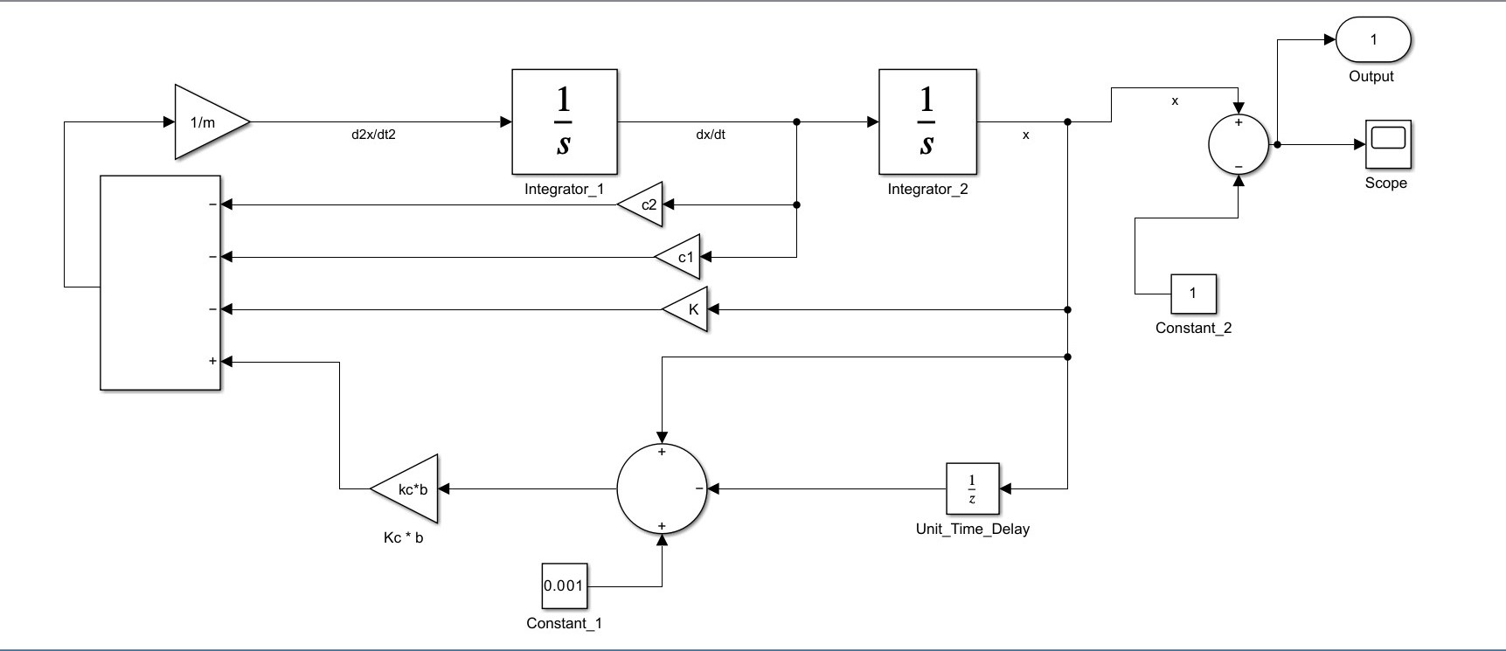
Simulink Model

Slide 9
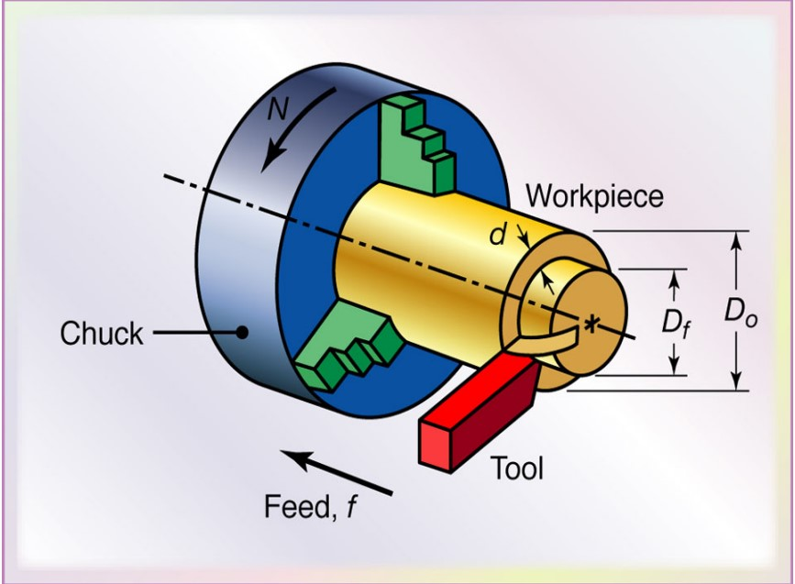
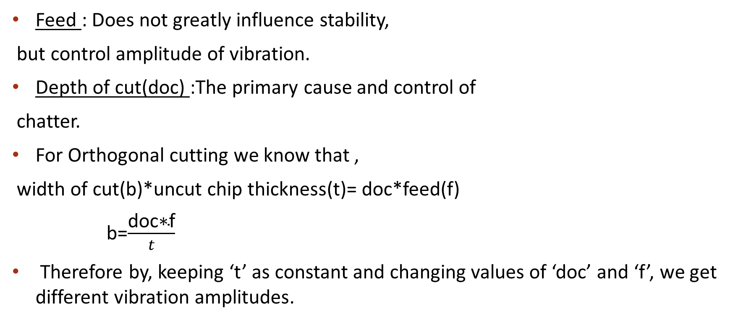
Factors Influencing Tool Chatter
Feed : Does not greatly influence stability,
but control amplitude of vibration.
Depth of cut(doc) :The primary cause and control of
chatter.
For Orthogonal cutting we know that ,
width of cut(b)*uncut chip thickness(t)= doc*feed(f)
b=$\frac{\text{doc}\text{∗}\text{f}}{t}$
Therefore by, keeping ‘t’ as constant and changing values of ‘doc’ and ‘f’, we get different vibration amplitudes.

Slide 10
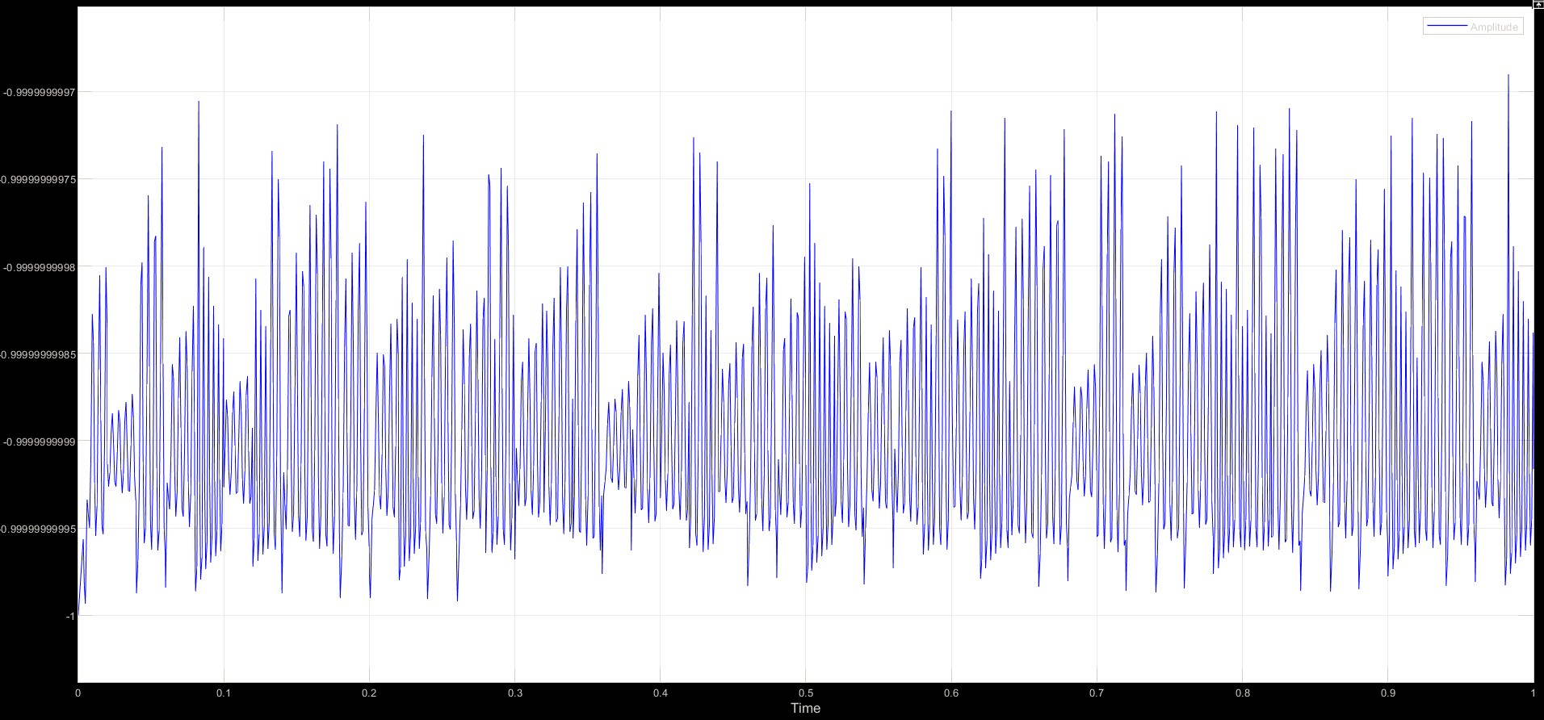
(a) Case 1 – feed = Constant , Depth of cut = 1.5 mm

Slide 11
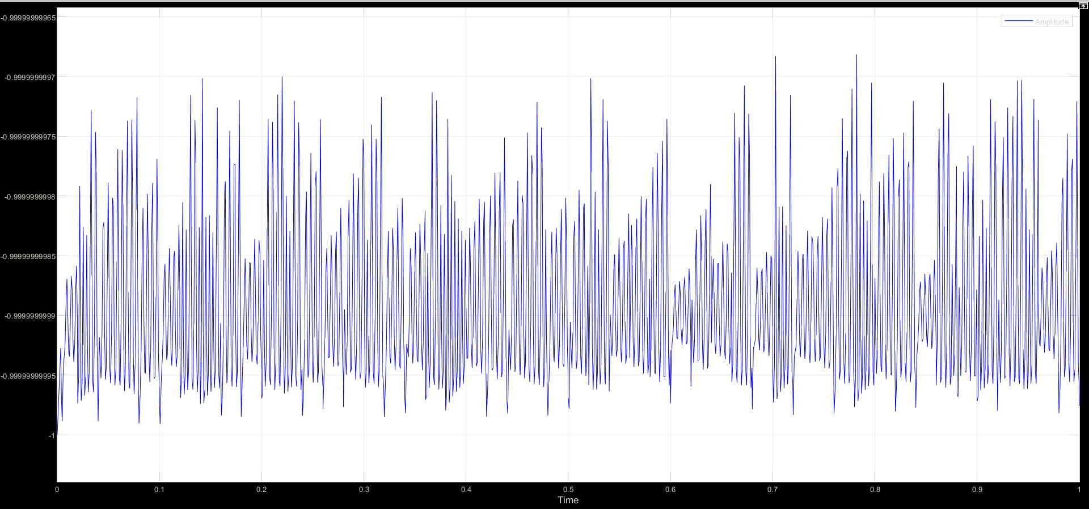
(a) Case 2 – feed = Constant , Depth of cut = 2.0 mm

Slide 12
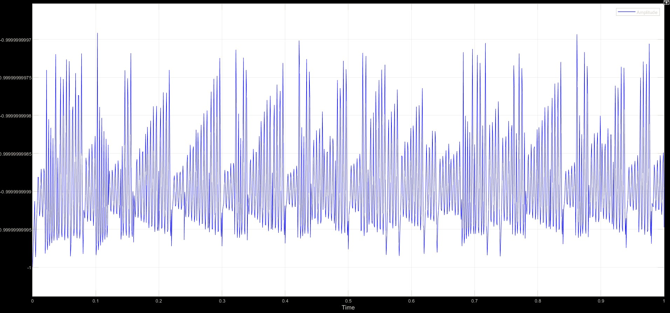
(a) Case 3 – feed = Constant , Depth of cut = 3.0 mm

Slide 13
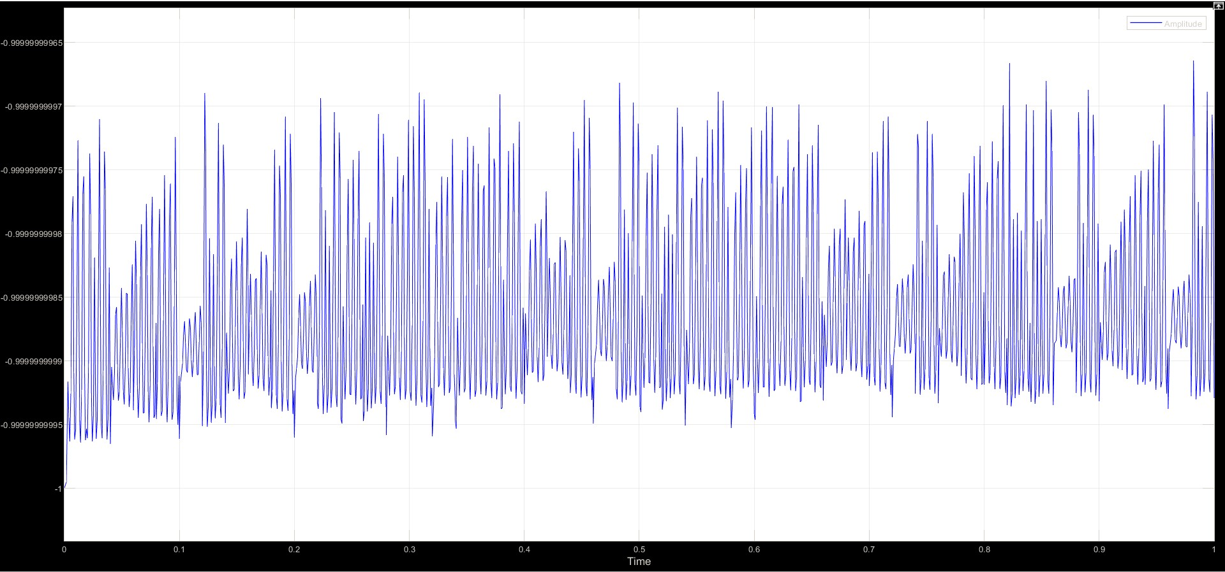
(b) Case 1 – feed = 0.6 mm/rev , Depth of cut = constant

Slide 14
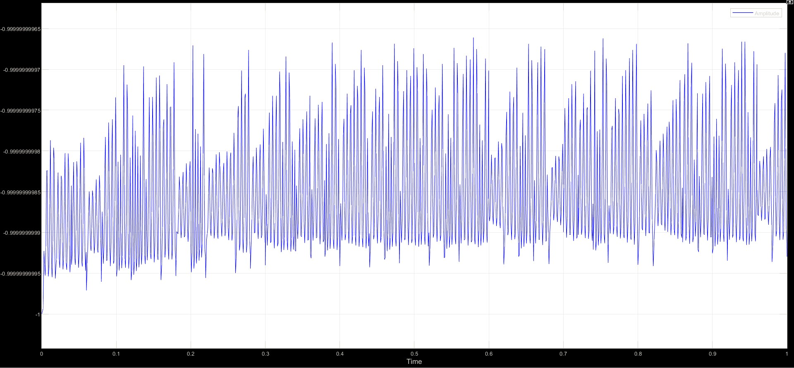
(b) Case 2 – feed = 0.8 mm/rev , Depth of cut = constant

Slide 15
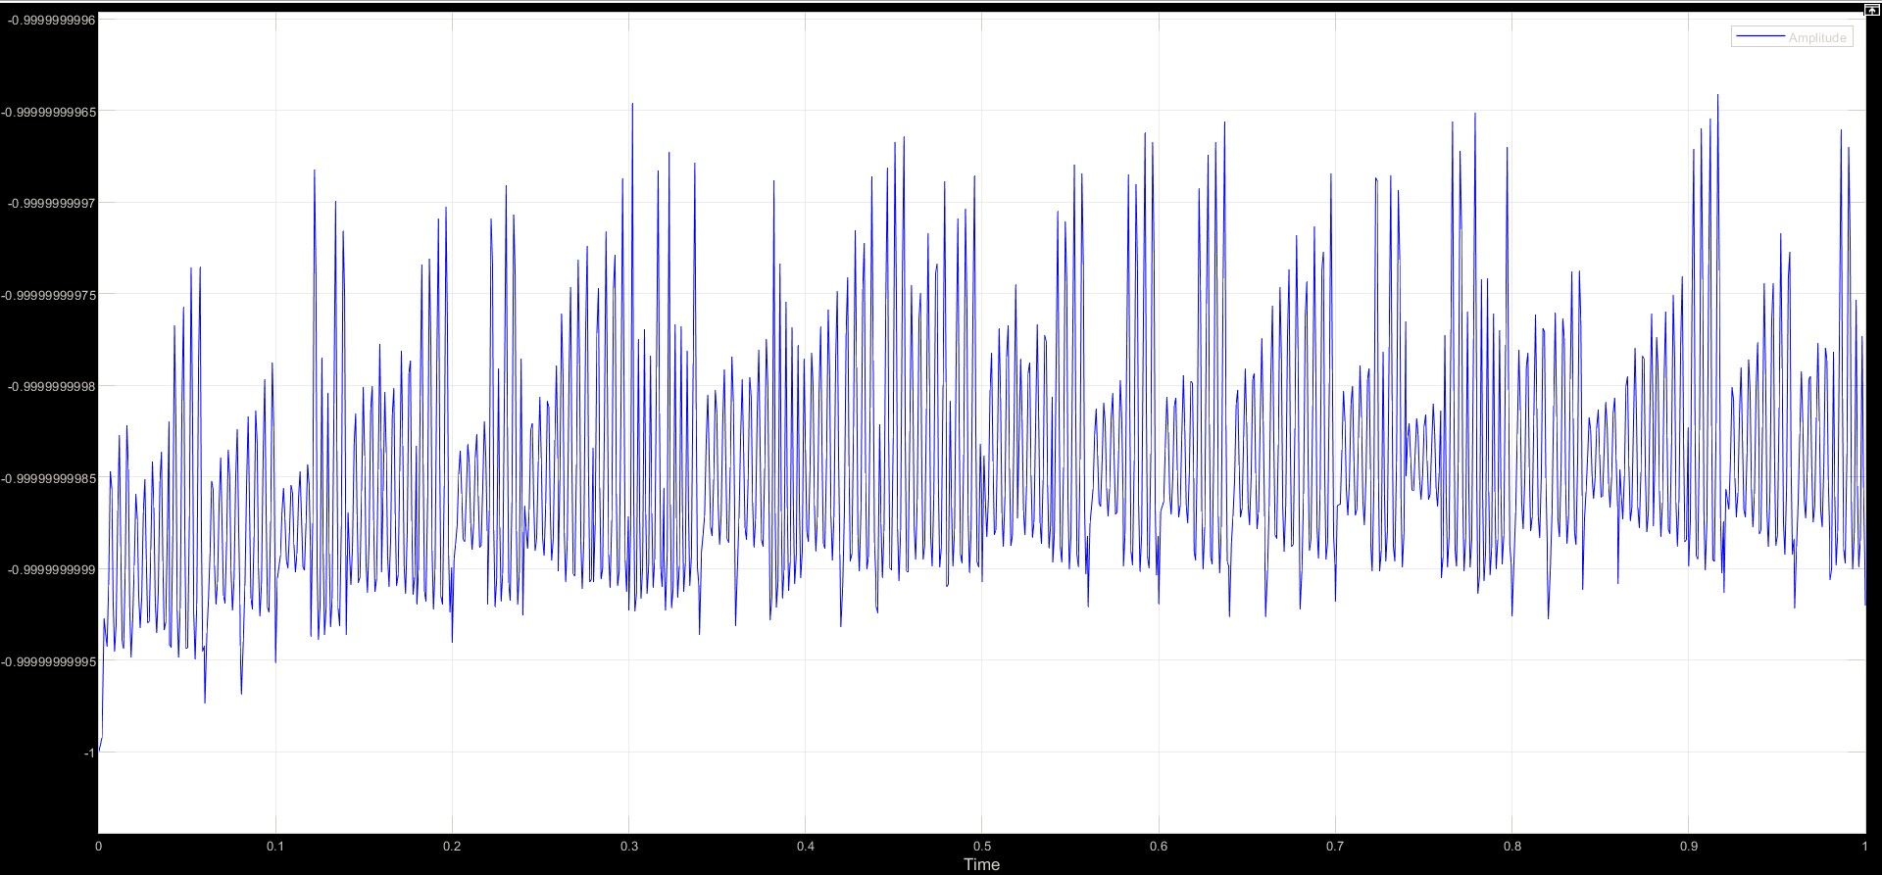
(b) Case 3 – feed = 1.0 mm/rev , Depth of cut = constant

Slide 16
Observation and Conclusion
With the help of Simulink model we simulate the tool chatter of tool during turning operation on lathe machine
From the Amplitude v/s time charts it is clearly evident that with an increase in the depth of cut there is an increase in the amplitude of vibration / tool chatter.
Same can be observed with respect to feed given to the tool, as feed given to the tool increases when the chattering of the tool increases
Therefore, there is always a need of proper spring and damping system to absorb all the vibration due to tool chatter and to decreases the surface roughness .

Slide 17
Reference
Dynamic analysis and stability prediction of nonlinear feed system coupled with flexible workpiece(2022).
Modeling and analysis of three-degree of freedom regenerative chatter in the cylindrical lathe turning(2017).
On-line metal cutting tool condition monitoring. I: Force and vibration analyses.
Study of Chatter Analysis in Turning Tool And Control Methods

